Slide 1

Numerical Modelling of the Influence of Atmos-pheric Conditions on Golf Ball Trajectories
Bachelor project, 2026
Meeting 5, date: 21-04-2026
GROUP 3
Eske Freiesleben
Jacob Manniche
J. Alfred Pedersen
Student ID
S234229
S234258
S230869

Slide 2
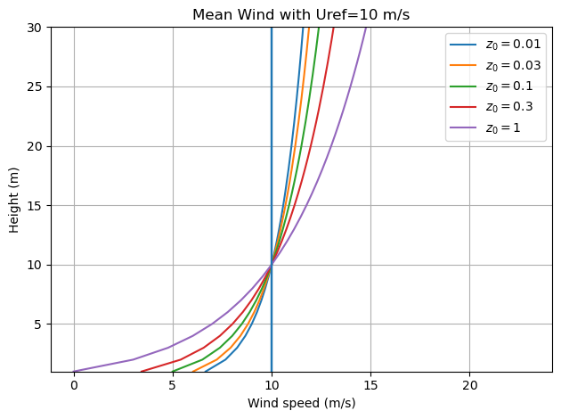
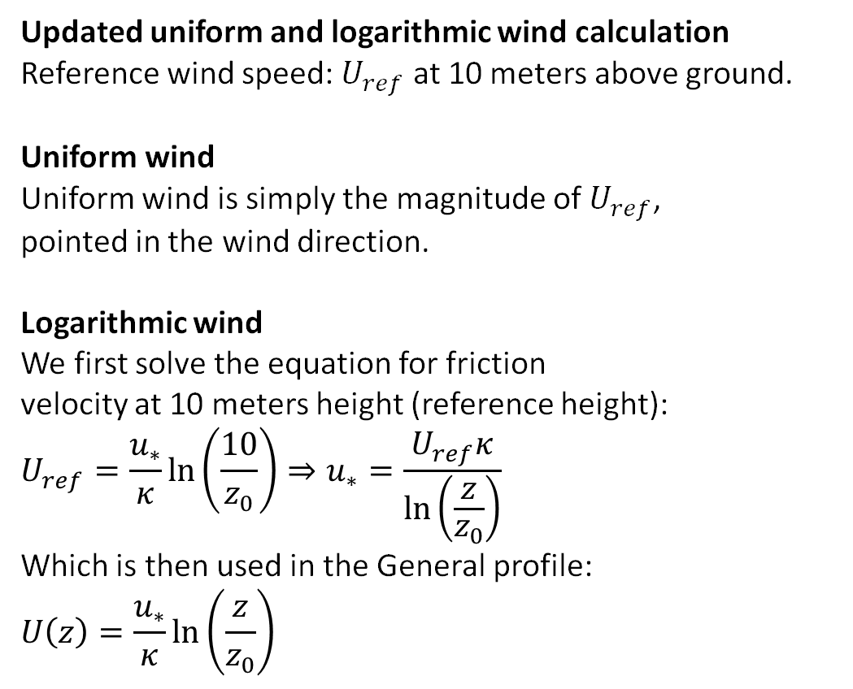
Logarithmic and Uniform wind comparison
Updated uniform and logarithmic wind calculation
Reference wind speed: $U_{ref}$ at 10 meters above ground.
Uniform wind
Uniform wind is simply the magnitude of $U_{ref}$,
pointed in the wind direction.
Logarithmic wind
We first solve the equation for friction
velocity at 10 meters height (reference height):
$$U_{ref}=\frac{u_{∗}}{κ}\ln\left(\frac{10}{z_{0}}\right)⇒u_{∗}=\frac{U_{ref}κ}{\ln\left(\frac{z}{z_{0}}\right)}$$
Which is then used in the General profile:
$$U\left(z\right)=\frac{u_{∗}}{κ}\ln\left(\frac{z}{z_{0}}\right)$$
Bachelor project:
Numerical Modelling of the Influence of Atmospheric Conditions on Golf Ball Trajectories

Slide 3
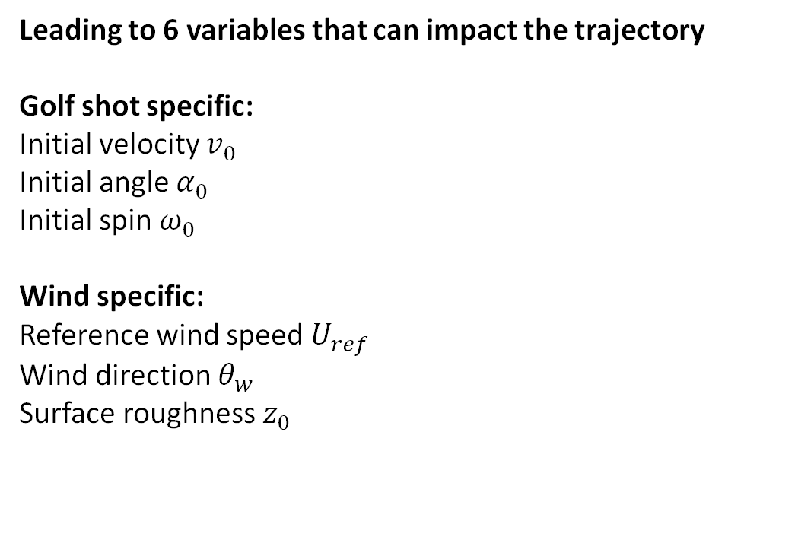
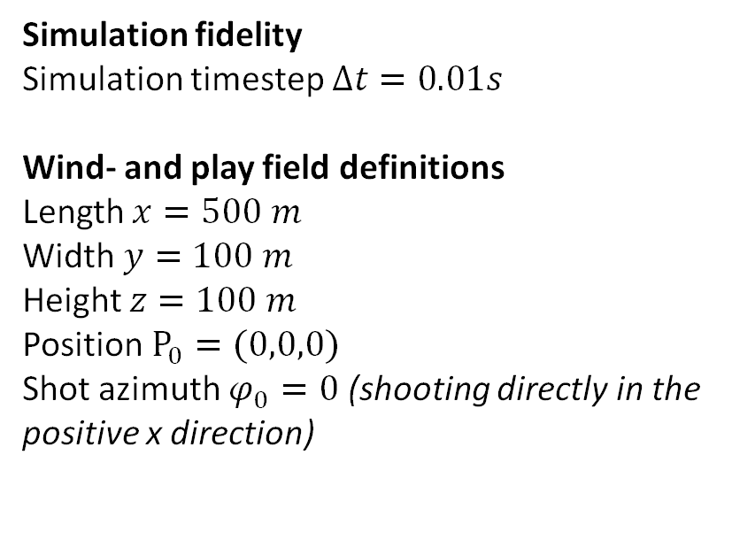
Trajectories with log and uniform wind
Leading to 6 variables that can impact the trajectory
Golf shot specific:
Initial velocity $v_{0}$
Initial angle $α_{0}$
Initial spin $ω_{0}$
Wind specific:
Reference wind speed $U_{ref}$
Wind direction $θ_{w}$
Surface roughness $z_{0}$
Simulation fidelity
Simulation timestep $Δt=0.01s$
Wind- and play field definitions
Length $x=500 m$
Width $y=100 m$
Height $z=100 m$
Position $P_{0}=(0,0,0)$
Shot azimuth $φ_{0}=0$ (shooting directly in the positive x direction)
Bachelor project:
Numerical Modelling of the Influence of Atmospheric Conditions on Golf Ball Trajectories

Slide 4
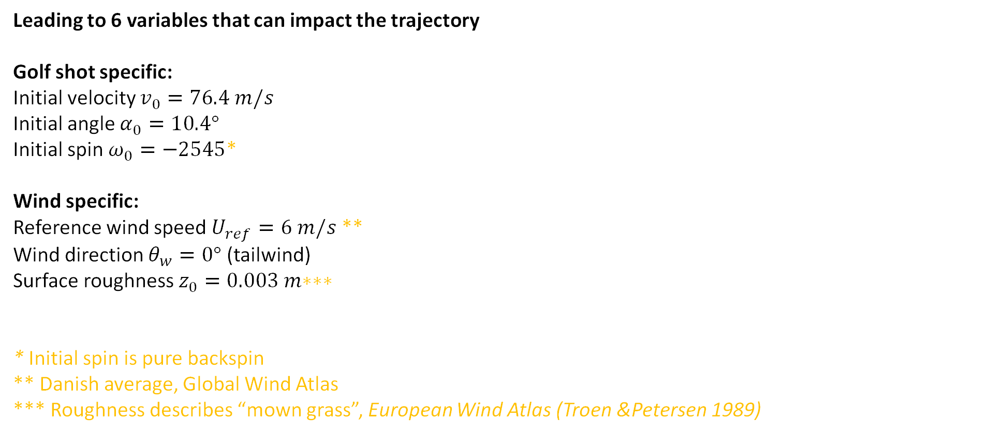
The “standard” shot and shot conditions
Leading to 6 variables that can impact the trajectory
Golf shot specific:
Initial velocity $v_{0}=76.4 m/s$
Initial angle $α_{0}=10.4°$
Initial spin $ω_{0}=−2545$*
Wind specific:
Reference wind speed $U_{ref}=6 m/s$ **
Wind direction $θ_{w}=0°$ (tailwind)
Surface roughness $z_{0}=0.003 m\text{∗}\text{∗}\text{∗}$
* Initial spin is pure backspin
** Danish average, Global Wind Atlas
*** Roughness describes “mown grass”, European Wind Atlas (Troen &Petersen 1989)
Simulation fidelity
Simulation timestep $Δt=0.01s$
Wind- and play field definitions
Length $x=500 m$
Width $y=100 m$
Height $z=100 m$
Position $P_{0}=(0,0,0)$
Shot azimuth $φ_{0}=0$ (shooting directly in the positive x direction)
Bachelor project:
Numerical Modelling of the Influence of Atmospheric Conditions on Golf Ball Trajectories

Slide 5
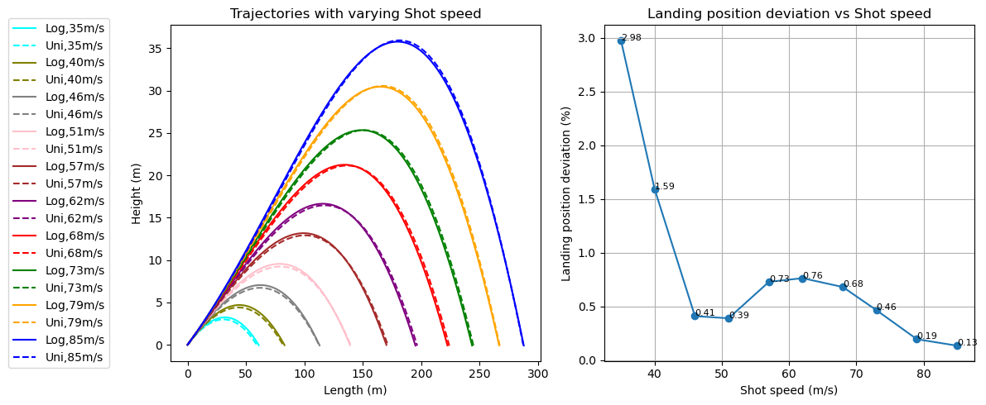
Logarithmic and Uniform wind comparison
Varying 1 of 6 variables to see its impact on trajectory and difference between uniform and log wind
Bachelor project:
Numerical Modelling of the Influence of Atmospheric Conditions on Golf Ball Trajectories

Slide 6
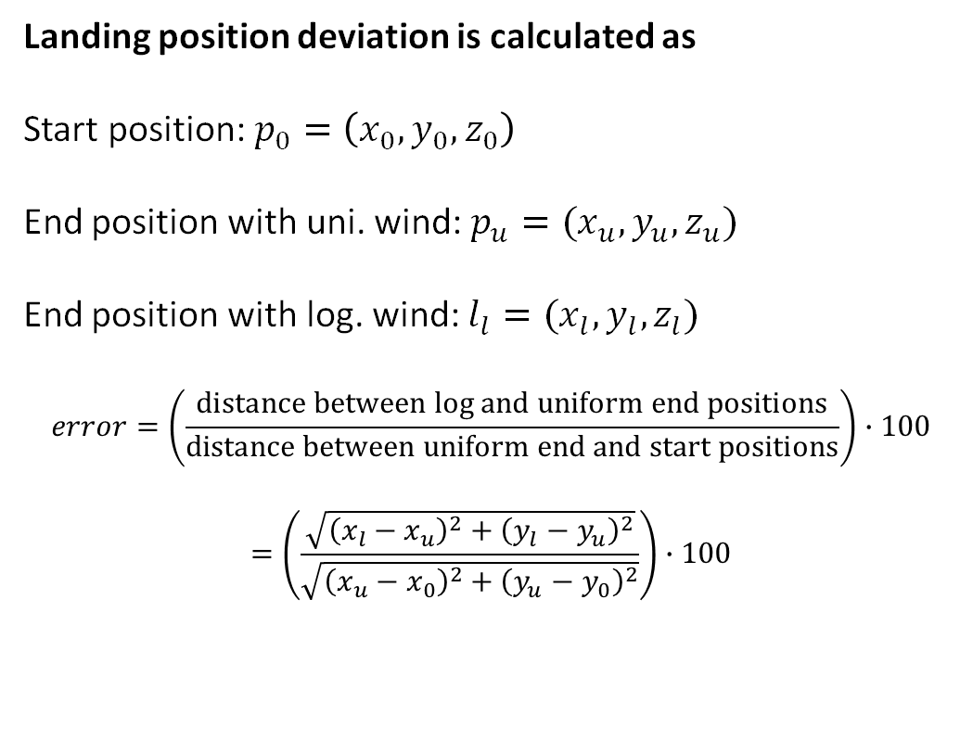
Logarithmic and Uniform wind comparison
Landing position deviation is calculated as
Start position: $p_{0}=\left(x_{0},y_{0},z_{0}\right)$
End position with uni. wind: $p_{u}=(x_{u},y_{u},z_{u})$
End position with log. wind: $l_{l}=(x_{l},y_{l},z_{l})$
$$error=\left(\frac{distance between log and uniform end positions}{distance between uniform end and start positions}\right)∙100$$
$$=\left(\frac{\sqrt{{\left(x_{l}−x_{u}\right)}^{2}+{\left(y_{l}−y_{u}\right)}^{2}}}{\sqrt{{\left(x_{u}−x_{0}\right)}^{2}+{\left(y_{u}−y_{0}\right)}^{2}}}\right)∙100$$
Bachelor project:
Numerical Modelling of the Influence of Atmospheric Conditions on Golf Ball Trajectories

Slide 7
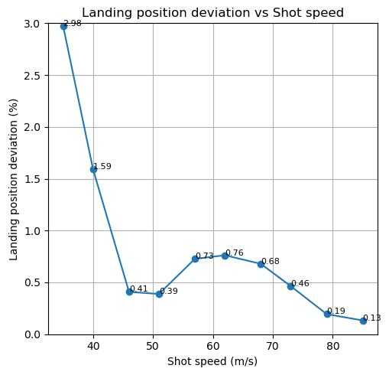
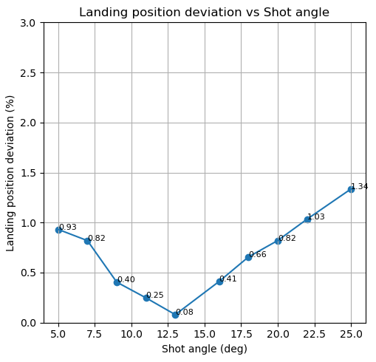
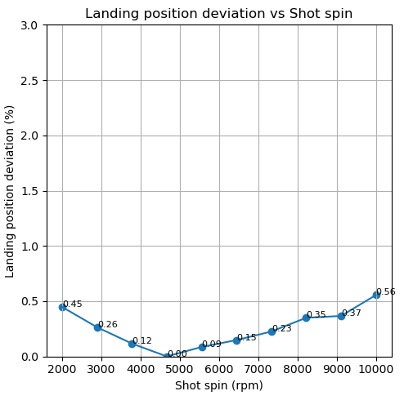
Logarithmic and Uniform wind comparison
Landing position deviation across the board is largest when varying shot speed, but let’s look closer at the golf shot variable variations
Bachelor project:
Numerical Modelling of the Influence of Atmospheric Conditions on Golf Ball Trajectories

Slide 8
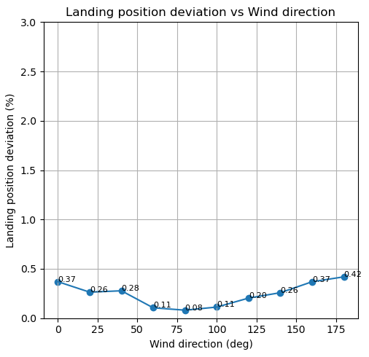
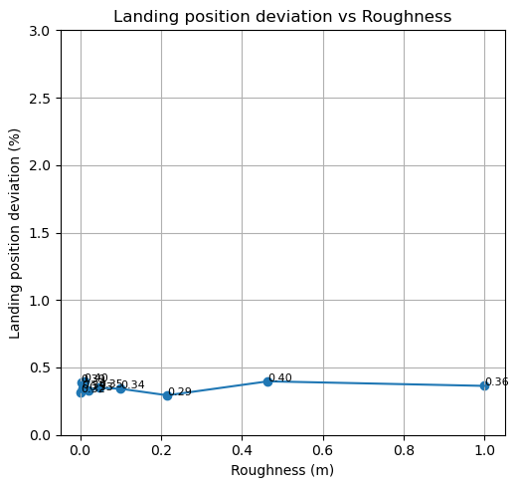
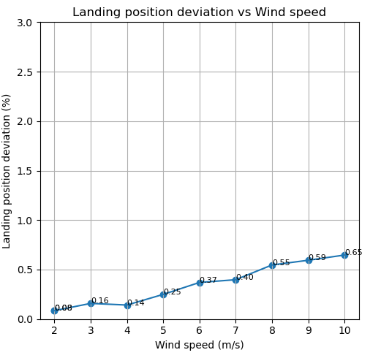
Logarithmic and Uniform wind comparison
.. And then we can look at the variations of wind parameters
Bachelor project:
Numerical Modelling of the Influence of Atmospheric Conditions on Golf Ball Trajectories

Slide 9
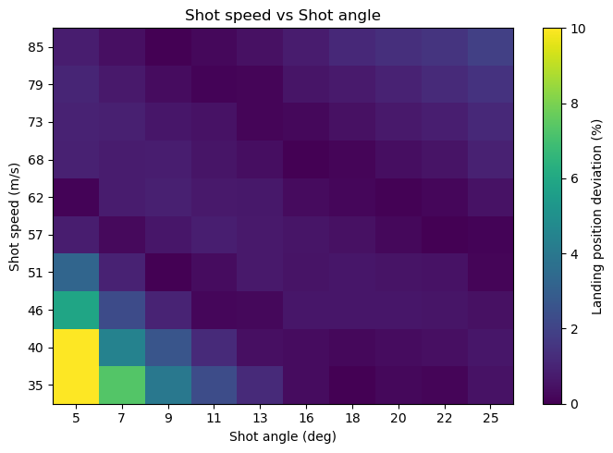
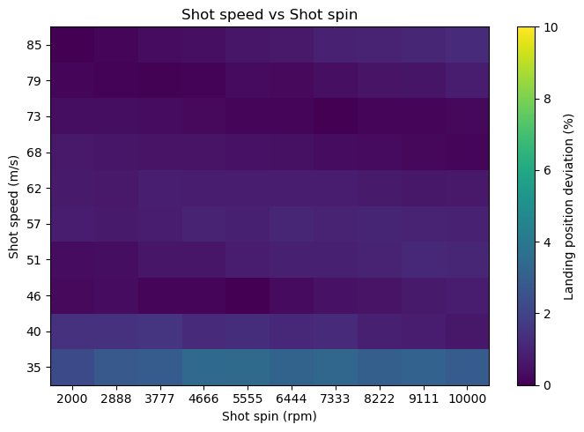
Logarithmic and Uniform wind comparison
If we want to change two variables simultaneously, we can make a heatmap of the error.
Bachelor project:
Numerical Modelling of the Influence of Atmospheric Conditions on Golf Ball Trajectories

Slide 10
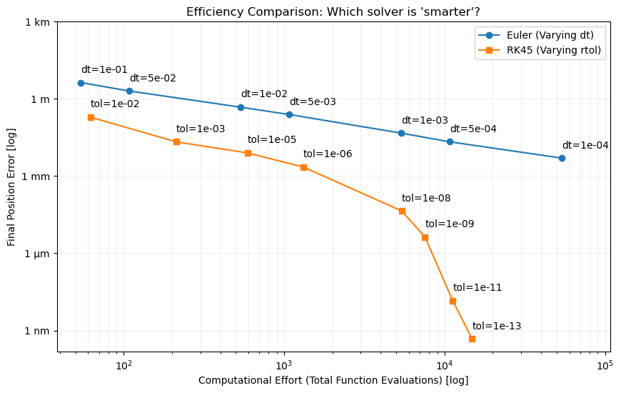
Comparison of different solvers
Evaluation of 1st-Order Euler vs. Adaptive RK45 compared on computational evaluations
Euler's method: - 1st order
- Simple
Precission depends on dt (lower is better)
Runge Kutta (RK45):
Adaptive 4/5th order
Advanced
Precission depends on tolerance (lower is better)
While Euler's method is simple to implement and understand, the RK45 is more precise, efficient and thus faster.
Bachelor project:
Numerical Modelling of the Influence of Atmospheric Conditions on Golf Ball Trajectories

Slide 11
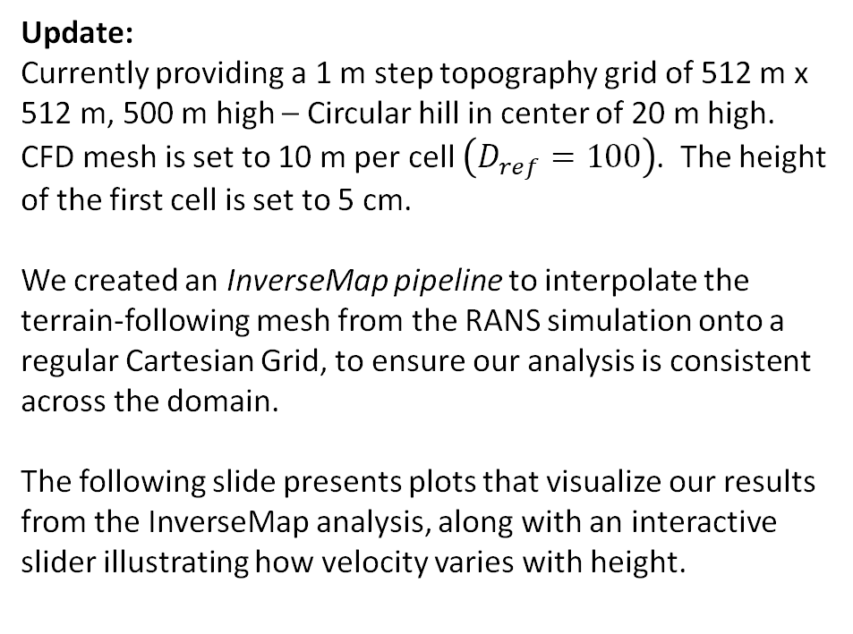
RANS Sim Update
Update:
Currently providing a 1 m step topography grid of 512 m x 512 m, 500 m high – Circular hill in center of 20 m high.
CFD mesh is set to 10 m per cell $\left(D_{ref}=100\right)$. The height of the first cell is set to 5 cm.
We created an InverseMap pipeline to interpolate the terrain-following mesh from the RANS simulation onto a regular Cartesian Grid, to ensure our analysis is consistent across the domain.
The following slide presents plots that visualize our results from the InverseMap analysis, along with an interactive slider illustrating how velocity varies with height.
Further work:
We’re currently working on refining the CFD mesh before proceeding with the corridor setup.
As part of this refinement, a mesh study can be conducted to assess the impact of cell size, rather than strictly adhering to an ideal 1-meter resolution. This may reveal that a coarser grid can be used without significantly compromising the results.
→ Use input.dat file to change grid function
Bachelor project:
Numerical Modelling of the Influence of Atmospheric Conditions on Golf Ball Trajectories
Notes:
Questions:
How can we aim for a finer resolution, e.g 1 m per cell in the CFD mesh?
To handle the increased computational load of the 1m resolution mesh, can we increase max_nodes? This would allow us to distribute the simulation across 48 total cores (24 cores per node).
If uniform 1m resolution is computationally too heavy, can we instead perform a 4 m x 4 m x 1 m resolution, to capture the anisotropic wind conditions, and to capture the high wind shear in the vertical direction?

Slide 12
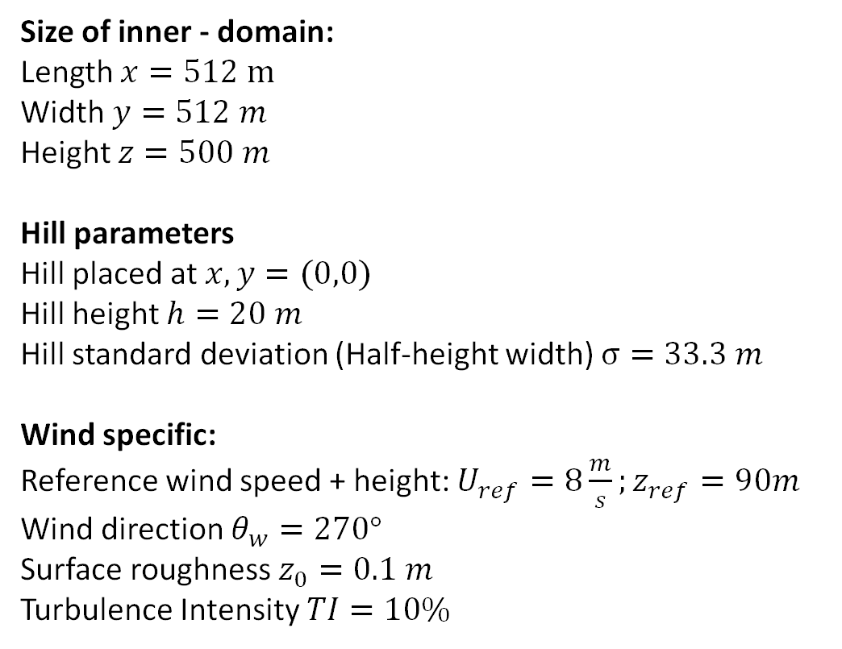
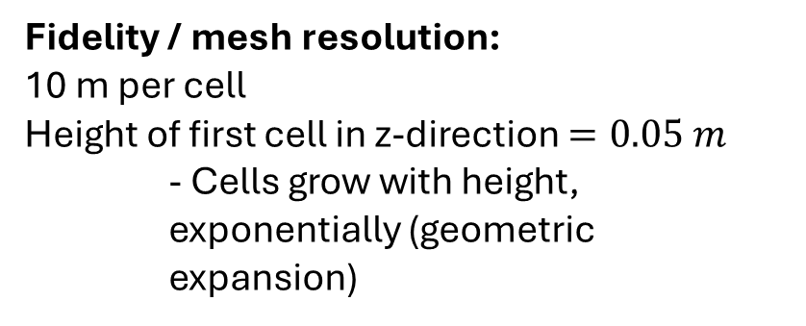
RANS Sim Update
We simulated the wind field over a Gaussian hill with the following parameters
Size of inner - domain:
Length $x=512 m$
Width $y=512 m$
Height $z=500 m$
Hill parameters
Hill placed at $x,y=(0,0)$
Hill height $h=20 m$
Hill standard deviation (Half-height width) $σ=33.3 m$
Wind specific:
Reference wind speed + height: $U_{ref}=8\frac{m}{s};z_{ref}=90m$
Wind direction $θ_{w}=270°$
Surface roughness $z_{0}=0.1 m$
Turbulence Intensity $TI=10\%$
Fidelity / mesh resolution:
10 m per cell
Height of first cell in z-direction $=0.05 m$
- Cells grow with height,
exponentially (geometric expansion)
Bachelor project:
Numerical Modelling of the Influence of Atmospheric Conditions on Golf Ball Trajectories

Slide 13
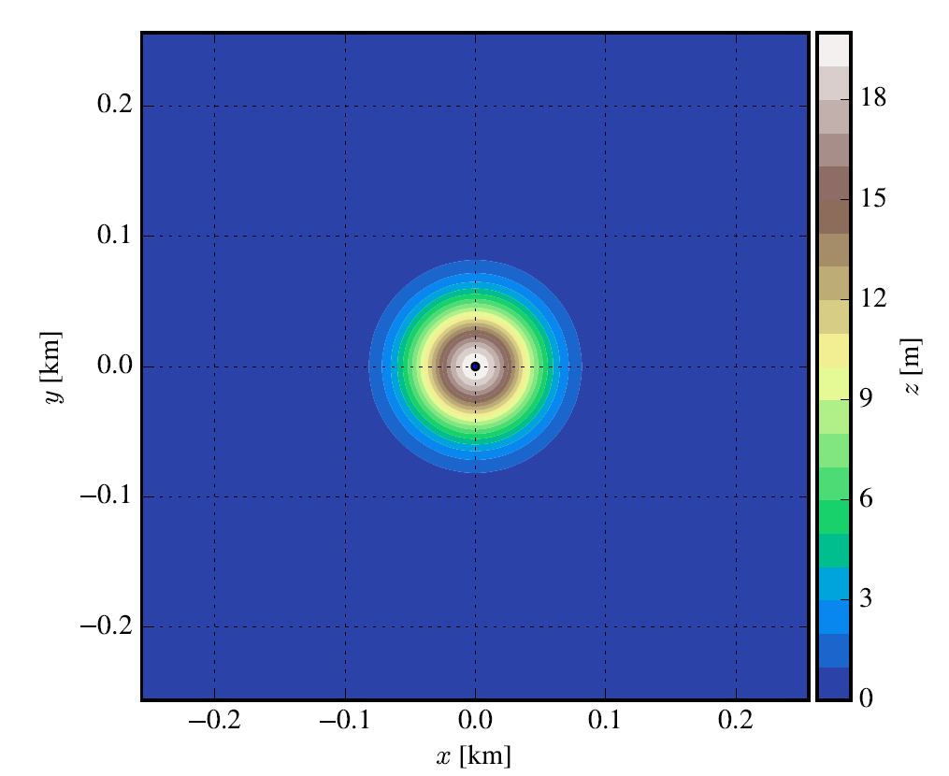
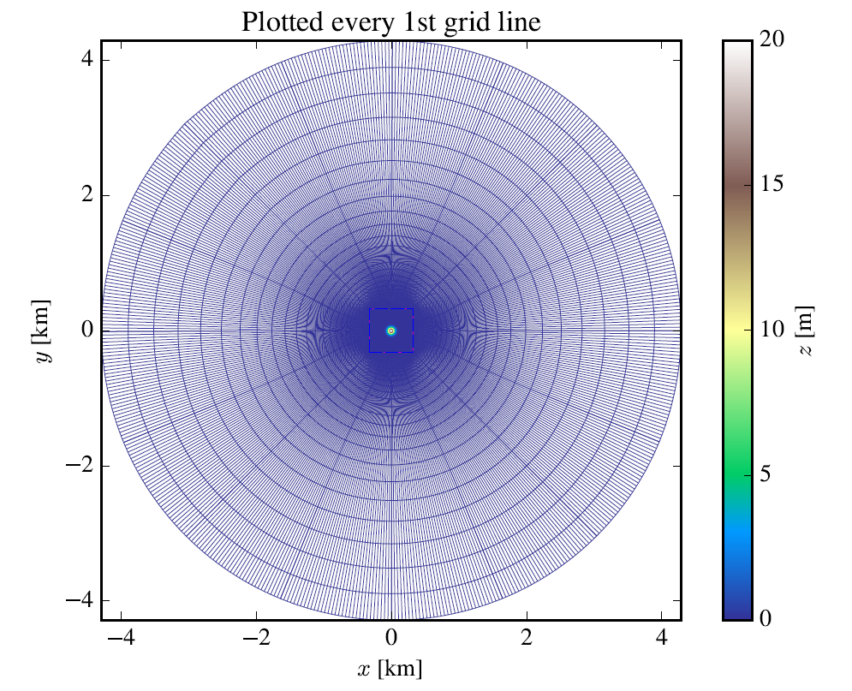
RANS Sim Update (Surface Mesh results)
Contour plot of topographical inner domain:
Assembled grid plot of inner + outer domain:
Bachelor project:
Numerical Modelling of the Influence of Atmospheric Conditions on Golf Ball Trajectories

Slide 14
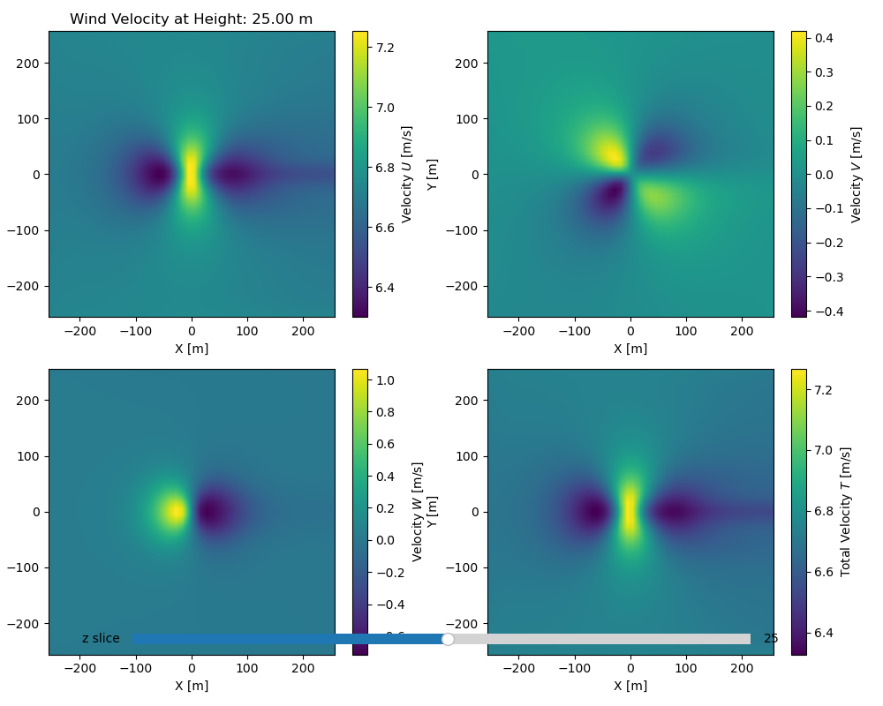
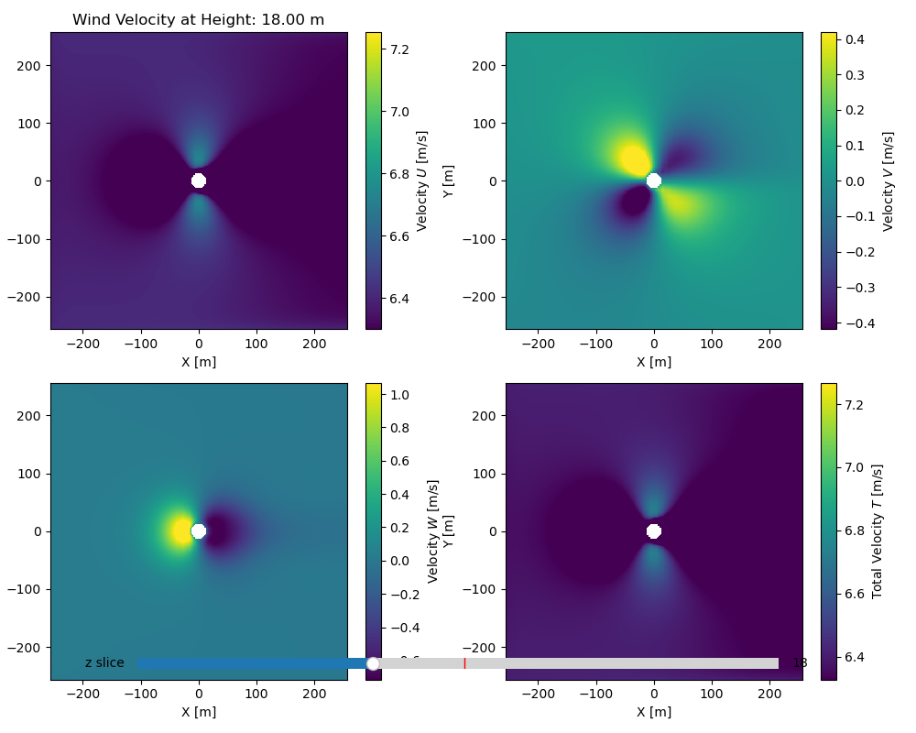


InverseMap results
Plot w. $z=25 m$ (5 m above hill):
Plot w. $z=18 m$:
Bachelor project:
Numerical Modelling of the Influence of Atmospheric Conditions on Golf Ball Trajectories

